Slide 1

Drone map project
By Dovydas Kundrotas

Slide 2
Data
Block #3959
Time: 00:02:12,052 --> 00:02:12,085
Metadata:
<font size="28">SrtCnt : 3959, DiffTime : 33ms
2024-08-07 11:57:05.745
[iso : 100] [shutter : 1/4000.0] [fnum : 170] [ev : 0] [ct : 5124] [color_md : d_cinelike] [focal_len : 240] [dzoom_ratio: 10000, delta:0],[latitude: 47.122074] [longitude: 12.830362] [rel_alt: 60.400 abs_alt: 2516.836] </font>
Timestamp
Latitude
Longitude
Rel_alt
abs_alt

Slide 3
Data extraction
'timestamp': re.compile(r'(\d{4}-\d{2}-\d{2} \d{2}:\d{2}:\d{2}\.\d{3})'),
'latitude': re.compile(r'latitude\s*:\s*([-\d.]+)'),
'longitude': re.compile(r'longitude\s*:\s*([-\d.]+)'),
'rel_alt': re.compile(r'rel_alt\s*:\s*([-\d.]+)'),
'abs_alt': re.compile(r'abs_alt\s*:\s*([-\d.]+)’)
We look for pattern and if we find it – we store location
<re.Match object; span=(13, 20), match=‘longitude’>
We extract data using x.group(1)
If it’s not timestamp, we change type to float
We append all_data list

Slide 4
How data is stored (using Pandas dataframe)

Slide 5
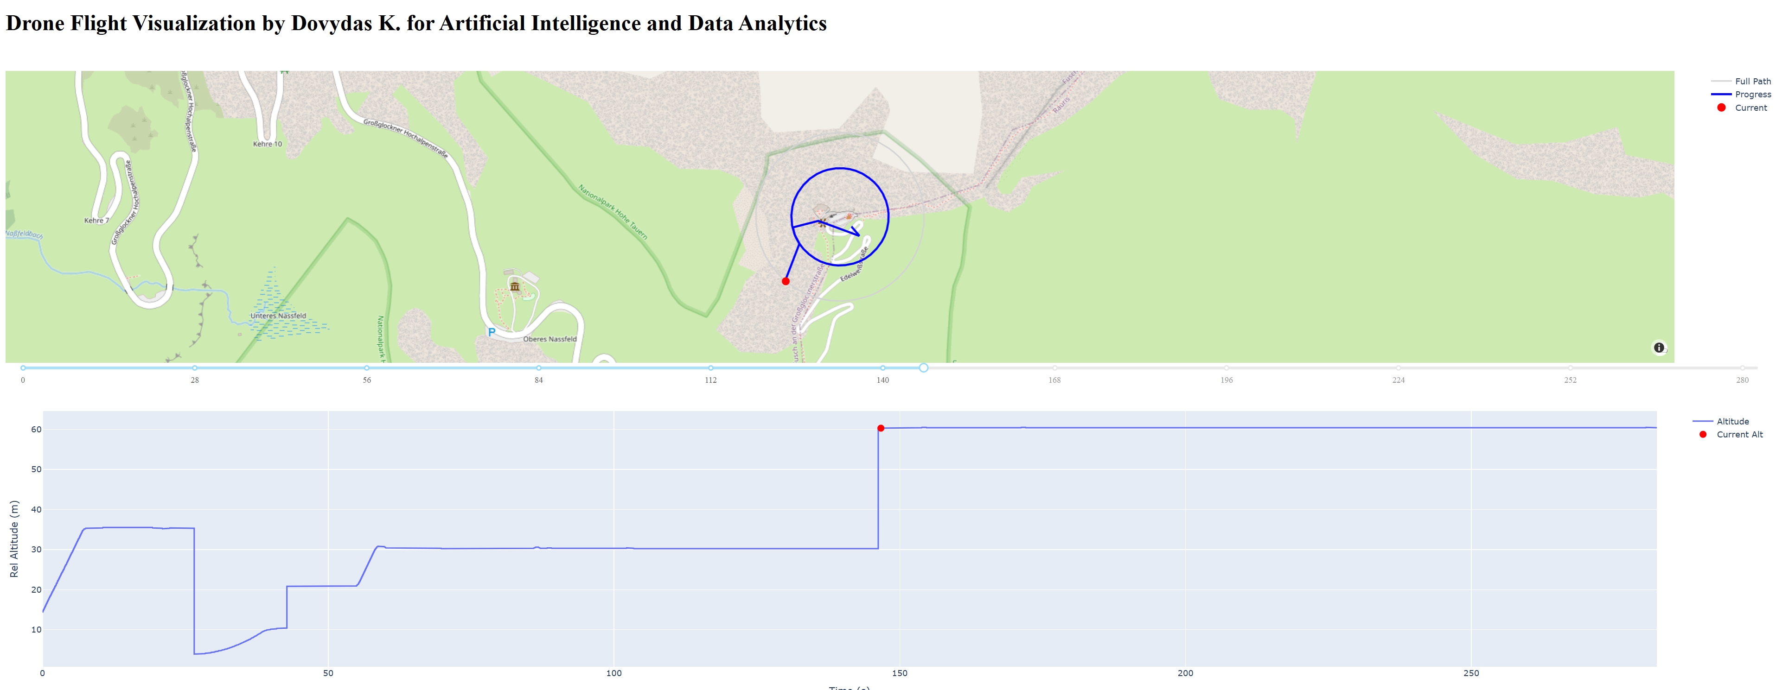
Result (using Dash & Ploty)

Slide 6
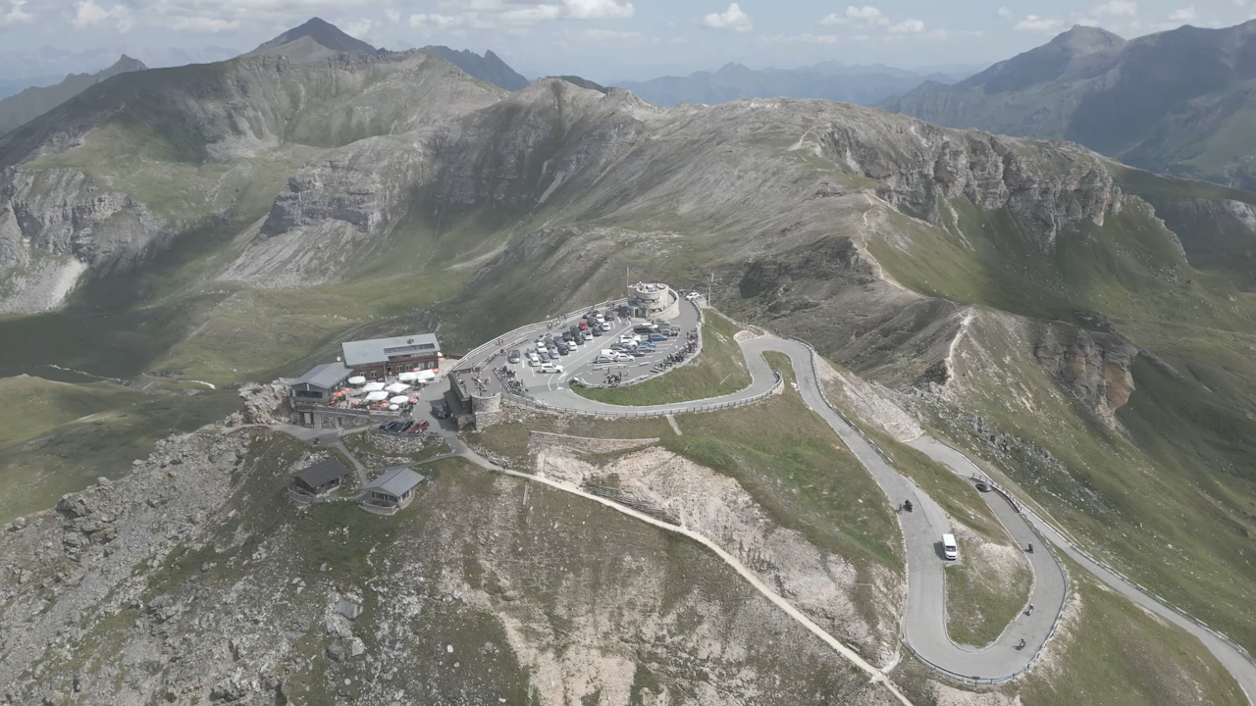
Thank you for attention

